Slide 1
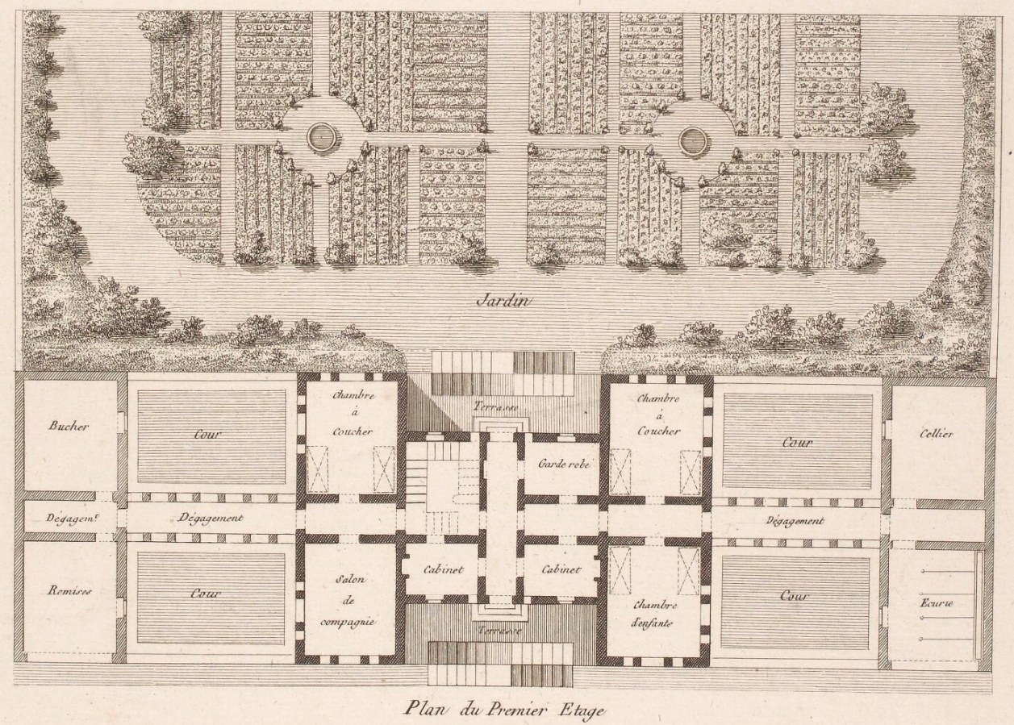
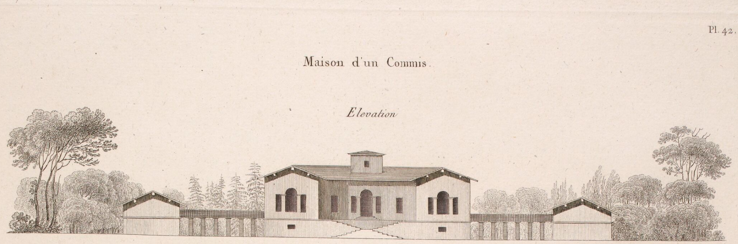
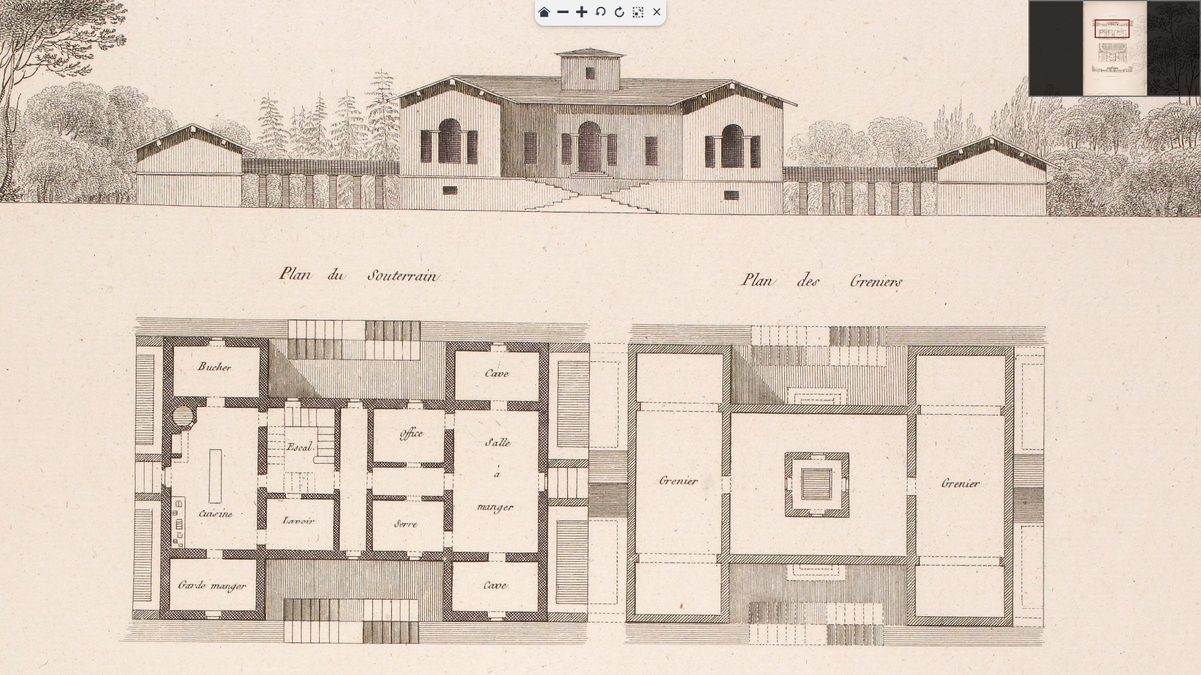
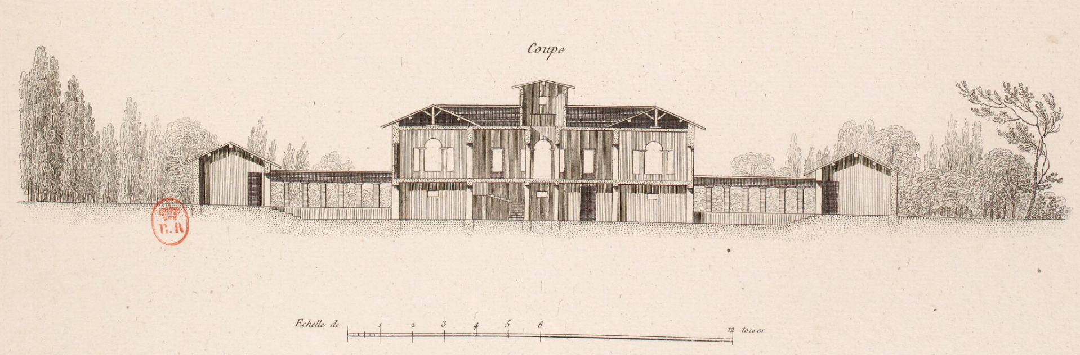



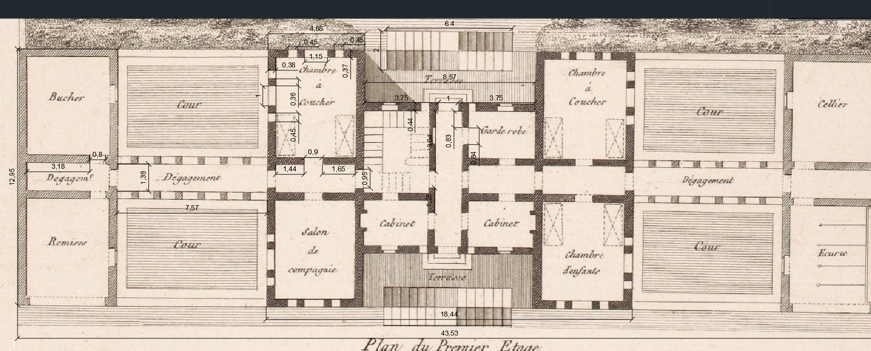
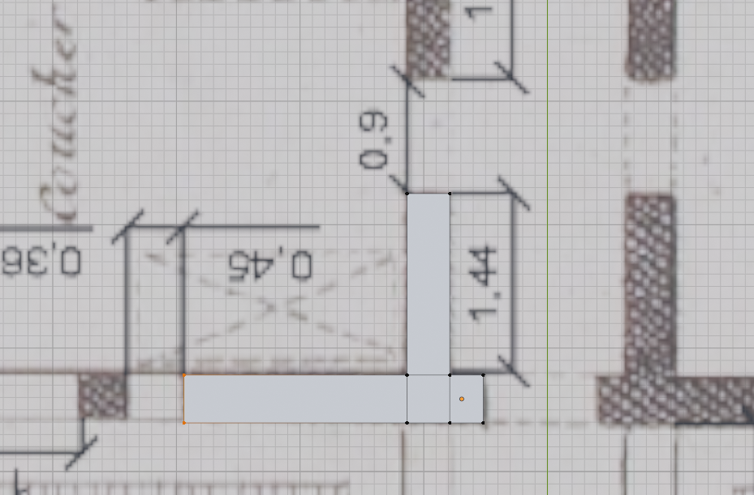
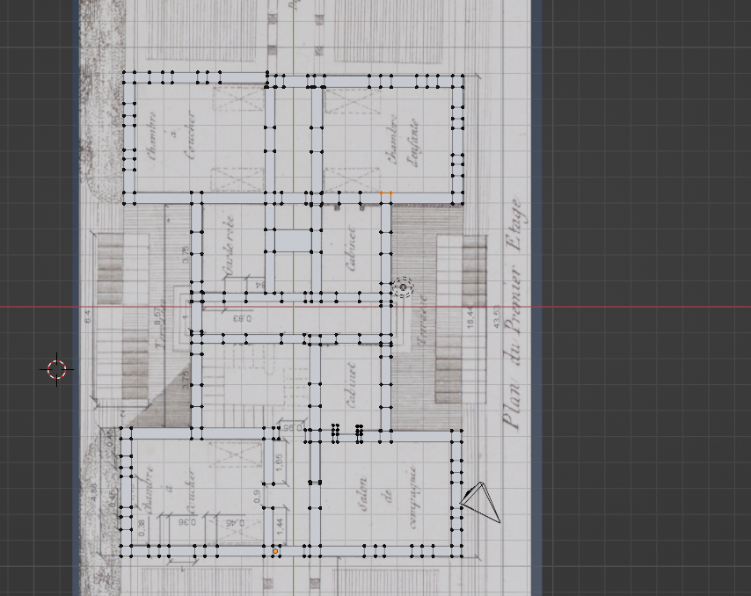
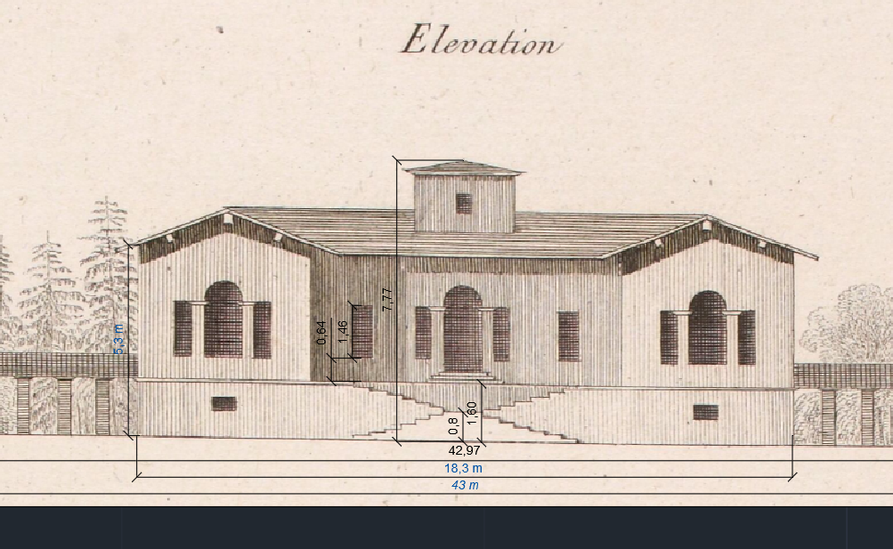
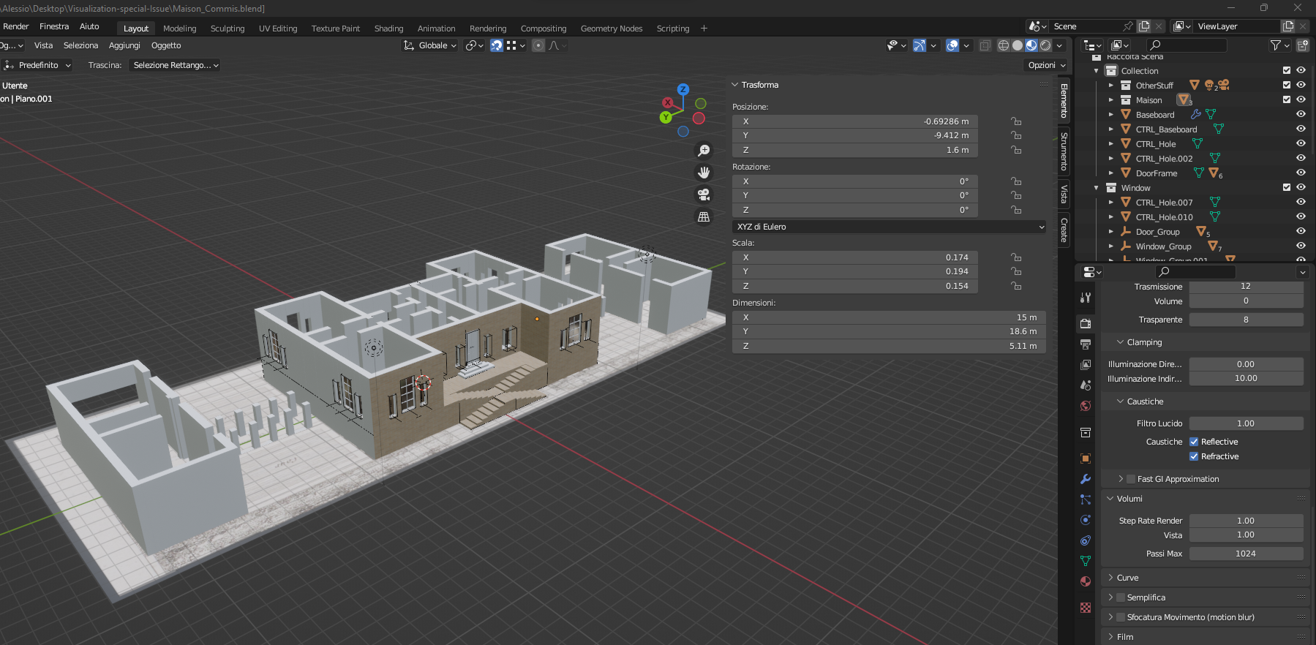
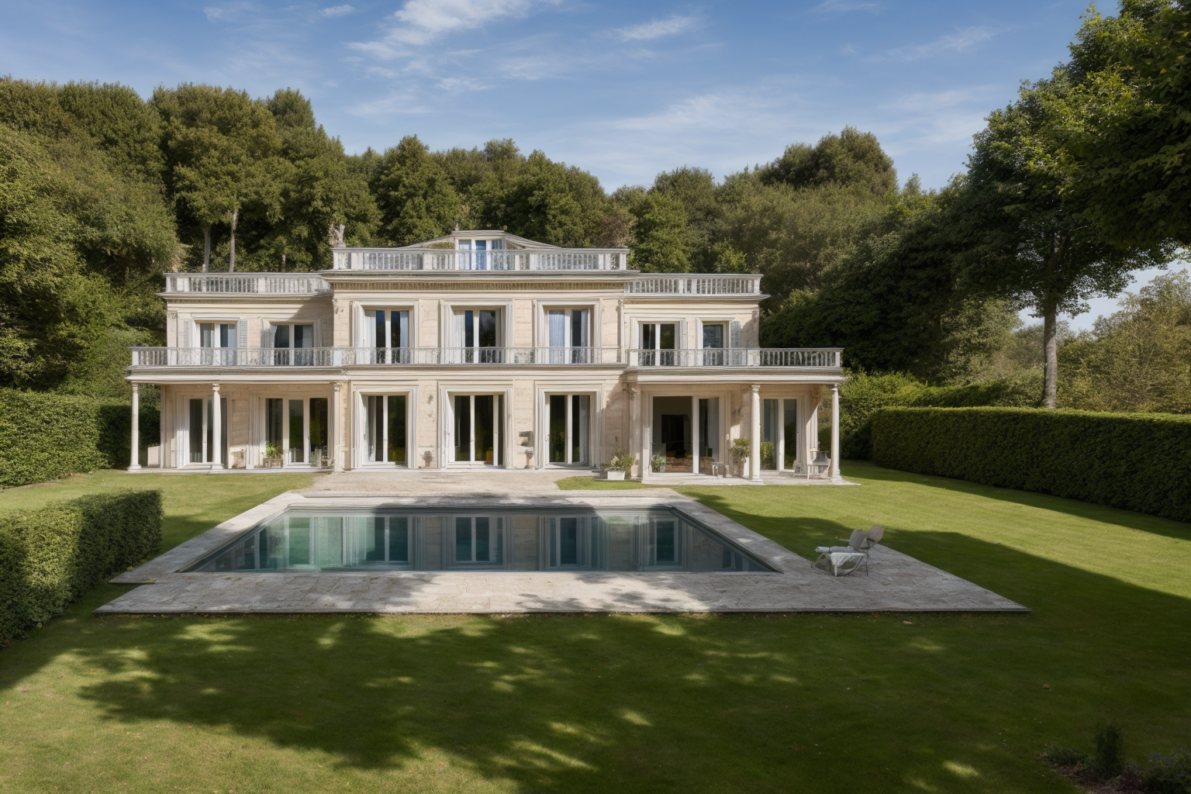
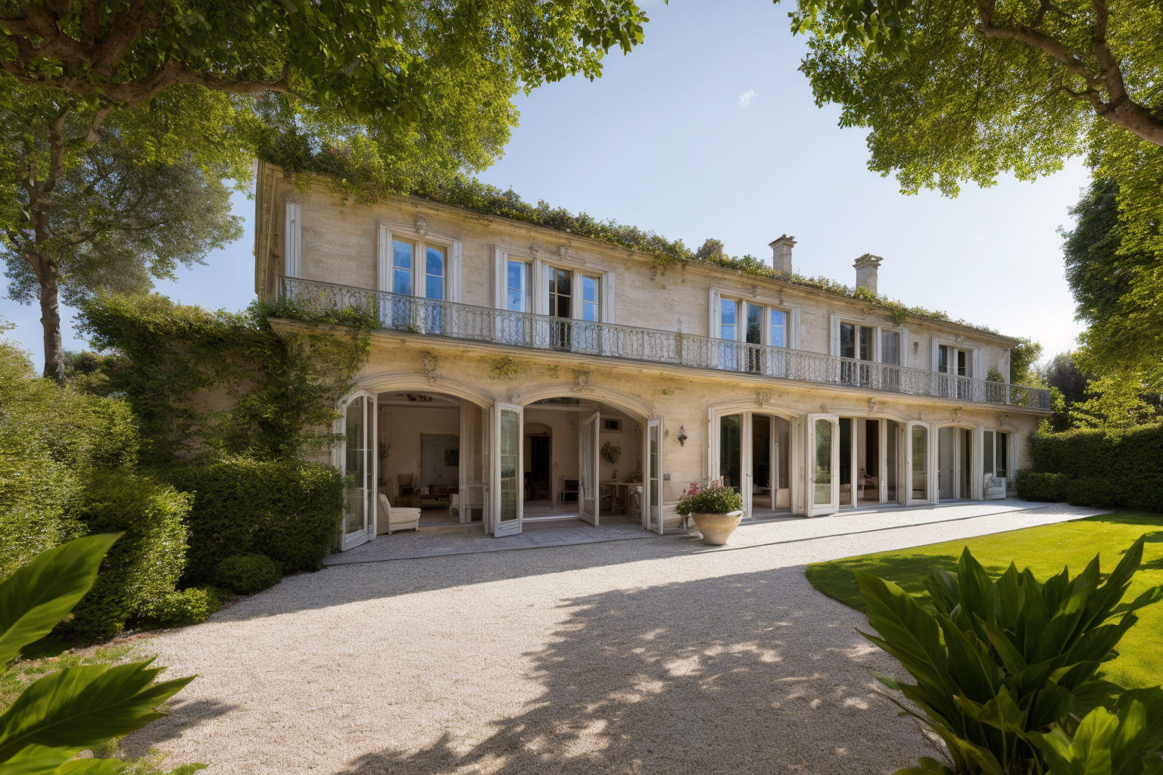
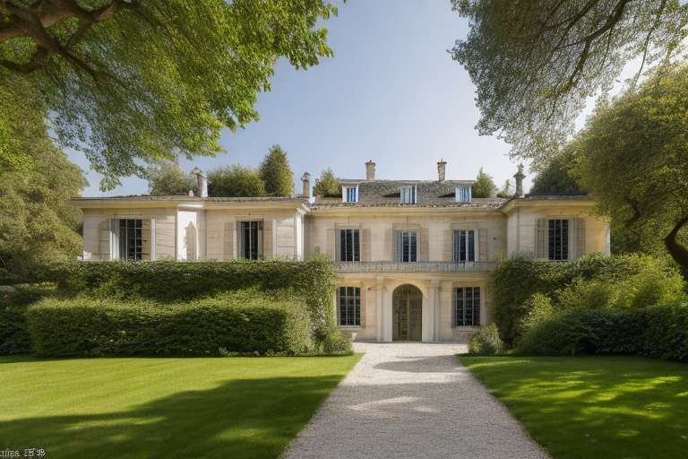
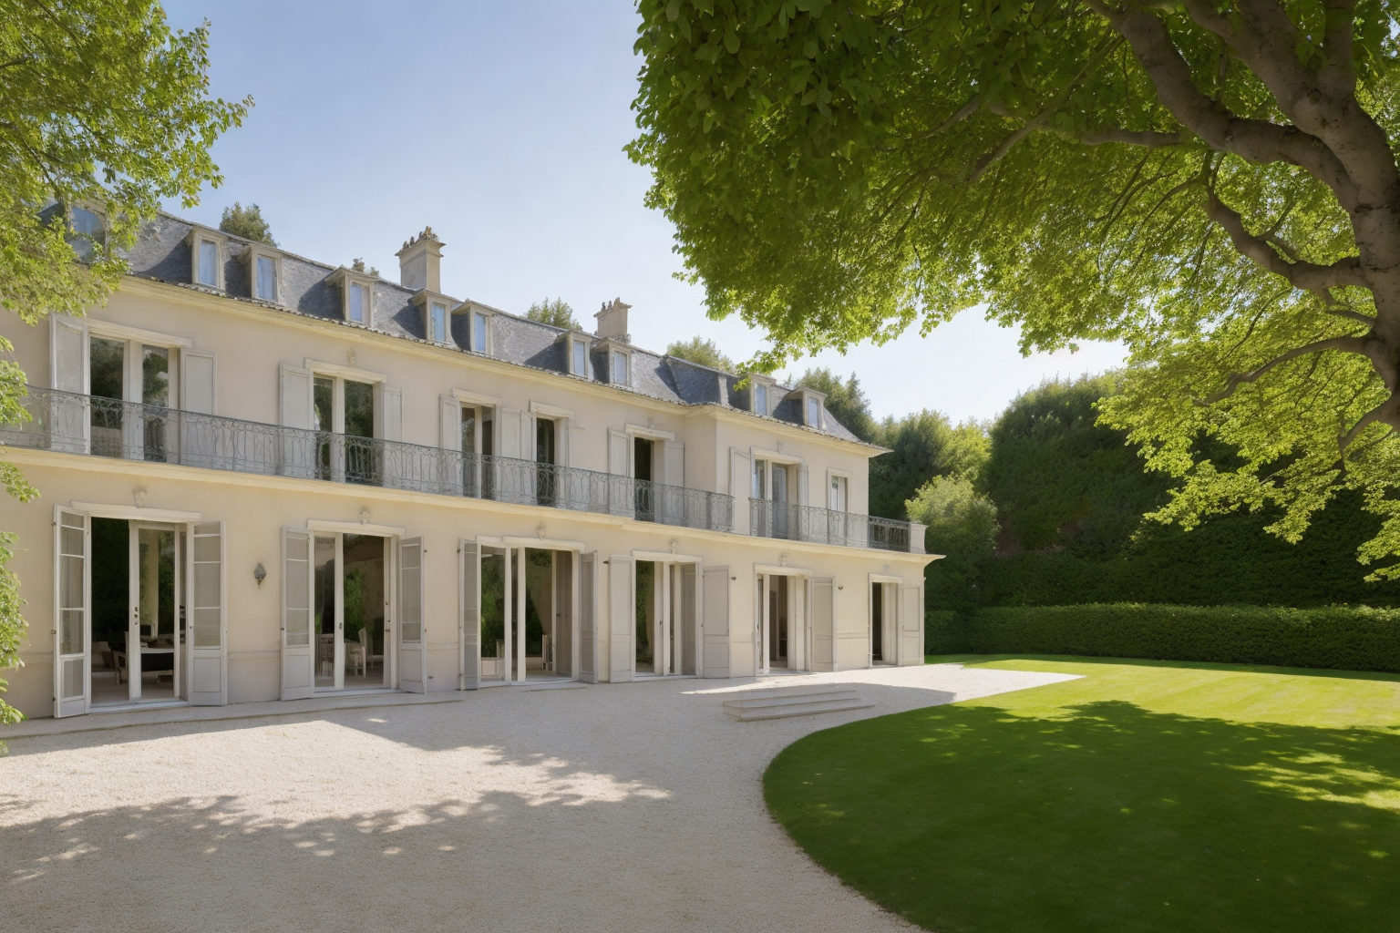
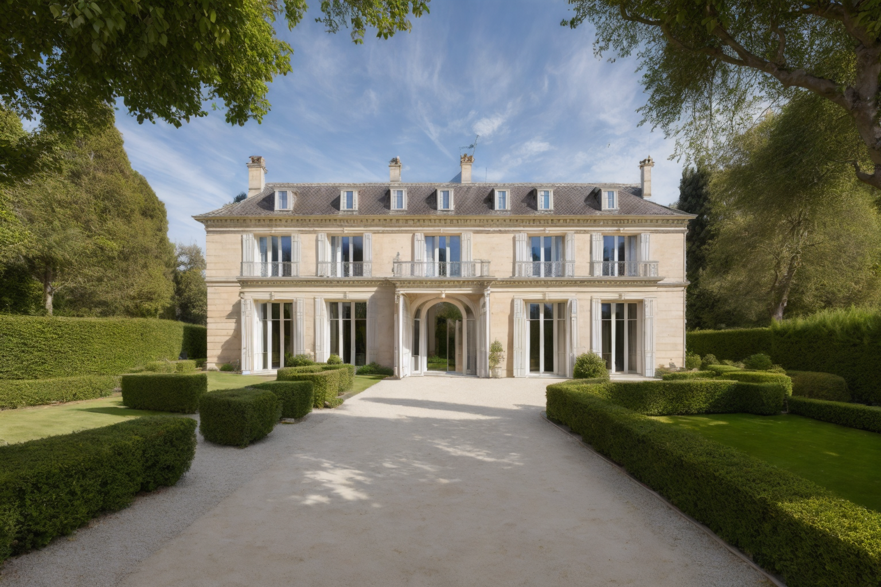
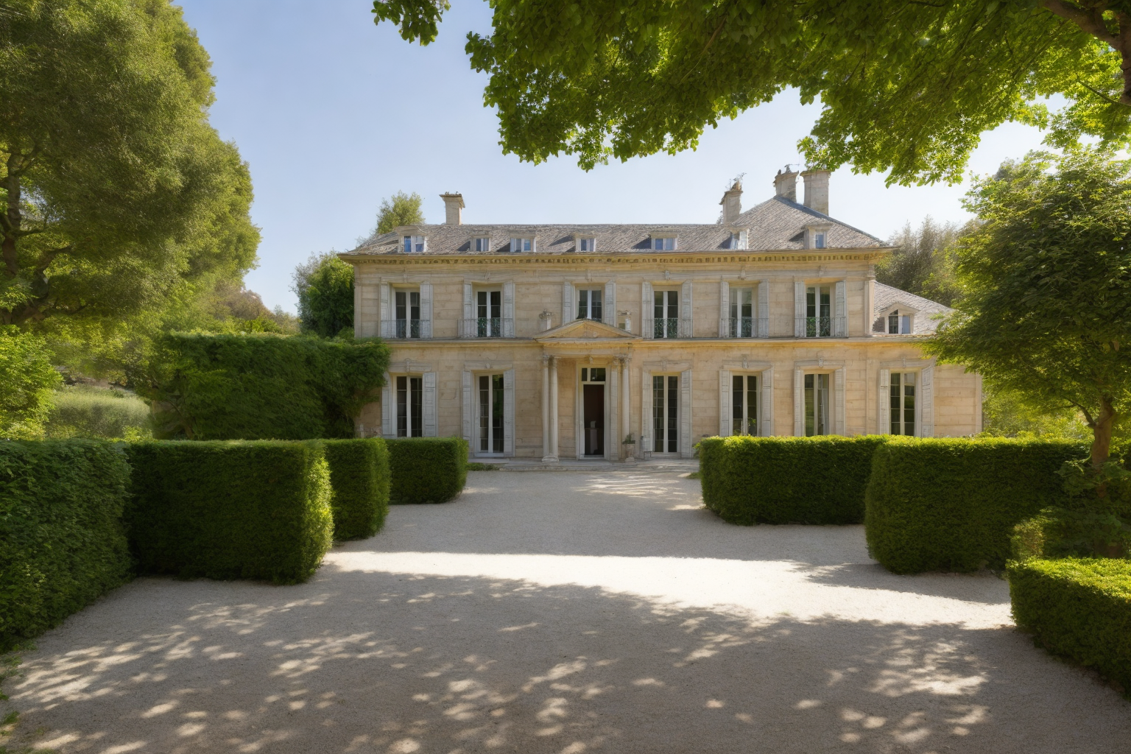
Assignment 16.11.23 Prepare an image of the chosen project (screenshot of the 3D model or rendering) following the guidelines presented in the seminar
Semester Project: The project entails the creation of a 3D model suitable for integration into Unity as an asset. This model is expected to encompass various elements, including the representation of the surrounding environment, lighting, external spaces, and internal spaces.
High resolution initial sketches, taken from https://gallica.bnf.fr/ark:/12148/bpt6k1047050b/f333.item
3D Modeling Progress:
Better and more precise measurements
Switched to blender for the 3 modeling, that is in a good point
Extras: 3D model (from a point of view of materials) AI Generated Images with Stable diffusion (waiting to finish the model to use it as an input to AI generated images)

